Slide 1
Dataset: Amazon Top 50 Bestselling Books 2009 - 2019
Topic: Is there a correlation between user ratings and reviews?
By: Ashwill Daniels
Date: 10 Sep 2022

Slide 2
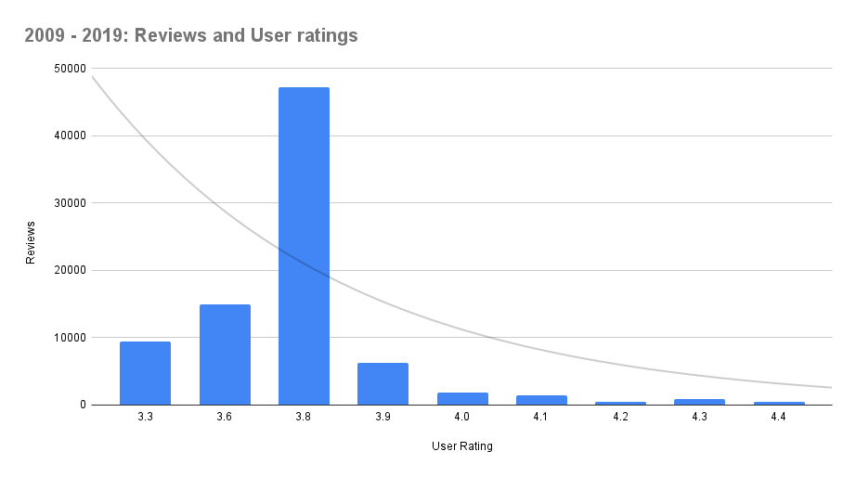
Years: 2009 - 2019

Slide 3
Year range split into:
2009 - 2012
2013 - 2016
2017 - 2019

Slide 4
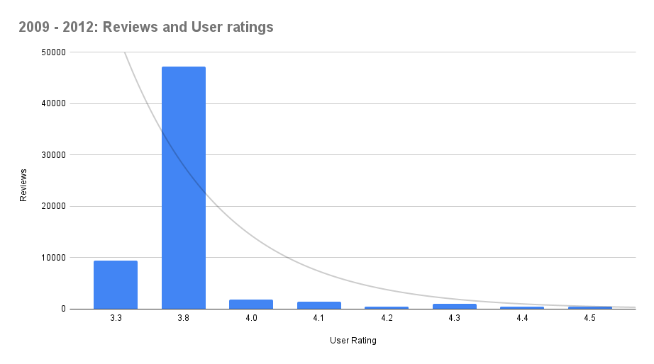
2009 - 2012

Slide 5
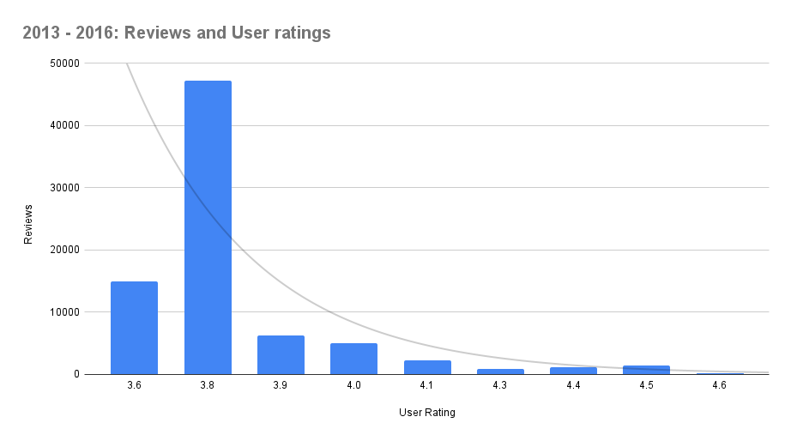
2013 - 2016

Slide 6
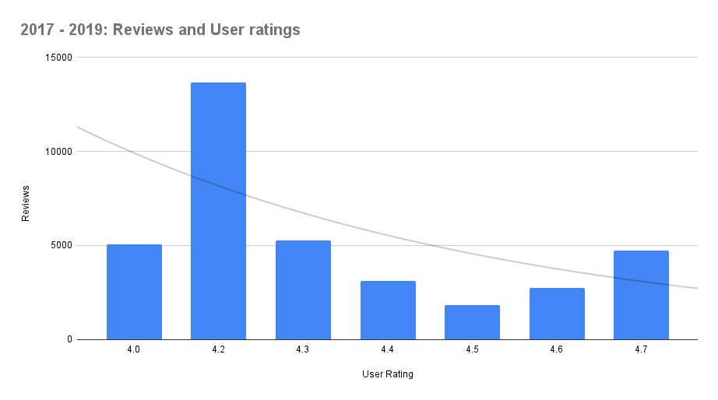
2017 - 2019

Slide 7
Conclusion
From the available data, I am lead to believe that the higher the user score for a book, the less likely it is to receive a review.

Slide 8
Appendix
Dataset:
Made available by: Sooter Saalu
License: CC0 - Public Domain
URL: https://www.kaggle.com/datasets/sootersaalu/amazon-top-50-bestselling-books-2009-2019
Tools used: Google Sheets and Google Slides

